Slide 1



The Processor (CPU)

Slide 2


Objectives
Students will be able to
Define the term processor
State the role of the CPU in processing data.
Describe the Von Neumann Architecture in data processing
Describe the role of each of the component of the processor
Describe the fetch-decode-execute cycle

Slide 3

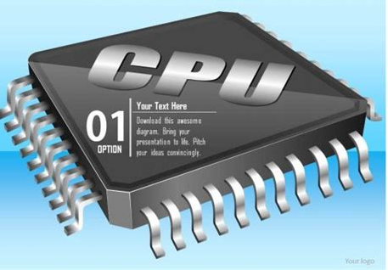
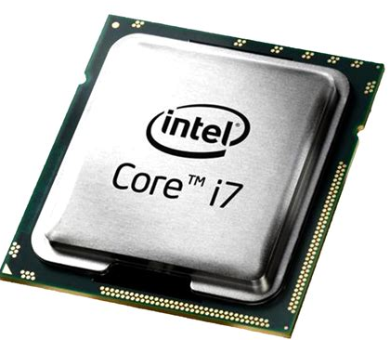
What is the CPU/Processor?
The CPU is the brain of the computer system. This is where the processing of all the data takes place. The CPU is commonly called the processor.
It is made up of billions of transistors (circuits) which are like small on and off switches. Electronics engineers integrates all these circuitries into one single silicon chip (the processor).

Slide 4


The Von Neumann architecture
Early computers were fed data while the machines were running.
It was not possible to store programs or data; that meant they could not operate without human intervention.
In the mid-1940s, John Von Neumann developed the concept of the stored Program computer.
This architecture describes the structure of a computer's central processing unit (CPU), which includes the arithmetic logic unit (ALU), control unit, memory, input/output devices, and registers.

Slide 5
The Von Neumann architecture
The main features of the Von Neumann Architecture
a central processing unit (CPU or processor) which contains the CU, ALU, Registers
Single memory (primary/main) where both data and instructions are stored
Input/output devices that provides buffering operations between the CPU and the computer devices
Bus system which allows infrastructure connection between the components of the computer system.

Slide 6

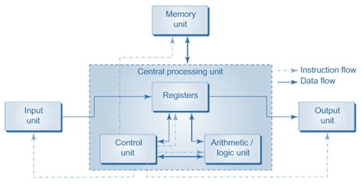
Von Neumann Architecture

Slide 7
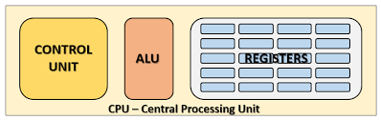
Parts of the CPU (processor)

Slide 8
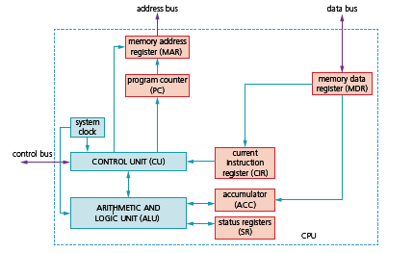
Components of the processor (CPU
The main components of the processor are
the arithmetic logic unit (ALU),
the control unit (CU),
the system clock
Immediate access store (IAS).

Slide 9
System Clock
The system clock in a processor is a crucial component that governs the timing of all computer operations
It is an electronic oscillator that generates a clock signal to synchronize the operations of the processor and other components in the computer.
This clock signal is a repetitive sequence of high/low pulses or 'ticks' that set the pace for executing instructions and coordinating various components.

Slide 10
Control Unit
The control unit controls the flow of data within the system. It checks that signals have been delivered successfully and makes sure that data goes to the correct place at the correct time.
The CU reads an instruction from memory (the address of the location where the instruction can be found is stored in the program counter (PC)).
This instruction is then interpreted. During that process, signals are generated along the control bus to tell the other components in the computer what to do.
The CU ensures synchronisation of data flow and program instructions throughout the computer

Slide 11
Arithmetic and logic Unit
Arithmetic and logic unit is where the CPU performs the arithmetic, comparison and logic operations.
The ALU allows the required arithmetic or logic operations to be carried out while a program is being run. It is possible for a computer to have more than one ALU – one will perform fixed point operations and the other floating-point operations Multiplication and division are carried out by a sequence of addition, subtraction and left/right shifting operations (for example, shifting 0 0 1 1 0 1 1 1 two places to the left gives 1 1 0 1 1 1 0 0, which is equivalent to multiplying by a factor of 4).

Slide 12
Immediate access store
Immediate Access store architecture was developed by Von Neumann. It refers to the main memory (RAM) because both data and program instructions can be access from this storage.
The memory in the IAS is organized as a single, large, random-access memory (RAM).
The memory is divided into fixed sized word, with each word typically representing a unit of data or instruction.
The size of a word is usually determined by the number of bits that CPU can process at once.

Slide 13
Activity
What is the difference between Registers and IAS?

Slide 14
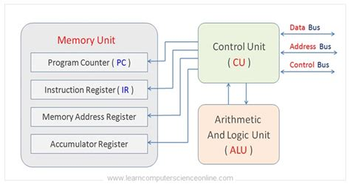
REGISTERS
Register:
One of the most fundamental components of the Von Neumann system is the register.
It is where the CPU holds all the data and programs that it is currently using.
Registers can be general purpose or special purpose.
General purpose registers hold data that is frequently used by the CPU or can be used by the programmer when addressing the CPU directly. Example accumulator.
Special purpose registers have a specific function within the CPU and hold the program state.

Slide 15
REGISTERS
General Register: Accumulator
General purpose registers hold data that is frequently used by the CPU
It is used for storing data for ALU to process and the results of those that are produced by the ALU.

Slide 16
REGISTERS
There main special registers are:
Program Counter (PC) - an incrementing counter that keeps track of the next memory address of the instruction that is to be executed once the execution of the current instruction is completed.
Memory Address Register (MAR) - the address in main memory that is currently being read or written. Use to access data and instructions from memory during the execution phase of instructions
Memory Buffer/Data Register (MBR/MBR) - a two-way register that holds data fetched from memory (and ready for the CPU to process) or data waiting to be stored in memory. this holds the data you have read from RAM or want to write to RAM.

Slide 17
REGISTERS-CIR
Current Instruction register (CIR) - this holds the current instruction being executed. a temporary holding ground for the instruction that has just been fetched from memory. (after being fetched from memory). stores the current instruction being decoded and executed

Slide 18
REGISTERS-IX
Index Register (IX)- it is a storage location in the CPU that holds a value that is used as an offset or base address for memory operations. Both are used to determine the exact location of data in the memory Base address: is the starting address of a block of memory. Example if you an array of integers in memory the base address would be address of the first element Offset address: the offset is the value that represents the distance (in bytes or words) from the base address to the specific item of interest in the block of memory. Example if you want to access the 5th element in an array the offset would be the number of bytes or words from the base address

Slide 19
REGISTERS-IX
Example
If the base address of an array is 1000 and you want to access the 5th element (assuming each element is 4 bytes), the offset would be 4 * 5 =20.
Adding this to the base address would give 1000 + 20 = 1020, which is where the 5th element is located.
This allows programs to work with data structure like arrays without needing to know the physical memory addresses. They would use base address and offset to navigate the memory space

Slide 20
REGISTERS-IX
Extra knowledge
Types of index registers
Index register (IX) this term is used in older architecture like the PDP-11
Index Register (X) used in IBM system 360 and later architectures
Index Register(IR) Found in ARM architecture
Base Index Register (BX) Used in x86 architecture
Index register (Xn) used in modern RISC architecture

Slide 21

Status register
Consider this arithmetic operation:
A status register is used when an instruction requires some form of arithmetic or logic processing.
Each bit is known as a flag.
Most systems have the following four flags.
Carry flag (C) is set to 1 if there is a CARRY following an addition operation.
Negative flag (N) is set to 1 if the result of a calculation yields a NEGATIVE value.
Overflow flag (V) is set to 1 if an arithmetic operation results in an OVERFLOW being produced.
Zero flag (Z) is set to 1 if the result of an arithmetic or logic operation is ZERO.
Since we have two positive numbers being added, the answer should not be negative.
The flags indicate two errors: a negative result, and an overflow occurred.

Slide 22
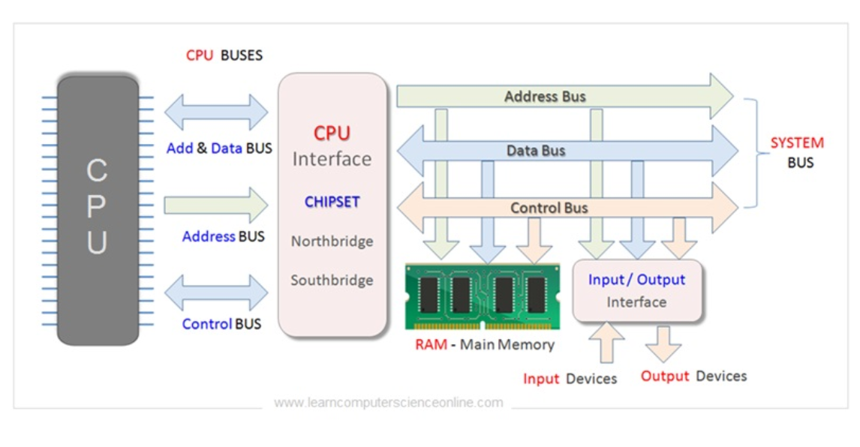
BUSES
Buses: ''The set of wires used to carry signals to and from CPU and different components of computer''
There are three types of buses according to three types of signals, these are:
Data Bus: ''The buses which are used to transmit data between CPU, memory and input output devices. Its bi-directional.
Address Bus: ‘‘The buses which connect the CPU with main memory and are used to identify particular locations (address) in main memory where data is stored.'' its uni-directional.
Control Bus: The wires which are used to transmit the control signals (instructions) generated by Control Unit to the relevant component of the computer. It can be uni-directional or bi-directional due to internal connections.

Slide 23
Fetch-Execute Cycle
The instruction cycle (also known as the fetch–decode–execute cycle, or simply the fetch-execute cycle) is the cycle that the central processing unit (CPU) follows from boot-up until the computer has shut down in order to process instructions.
It is composed of three main stages:
Fetch – gets the next program command from the computer’s memory
Decode – deciphers what the program is telling the computer to do
Execute – carries out the requested action
Store – saves the results to a Register or Memory
The basic steps involved in executing an instruction within the processor is called the instruction cycle/ fetch-execution cycle

Slide 24
Fetch-Execute Cycle
Step 1-fetching the instructions To fetch the instructions the CPU make use of the CU and the address bus. Data from this address is then moved from main memory into the registers in the CPU by travelling along the data bus. Registers are then used to stored and move the data to a special register that will decode the instruction.
Step 2 decode the instruction The ALU now needs to understand the instruction that was just fetched (from ram). To do this the instructions needs to be decoded. The moving of data and the decoding of instructions is controlled by the control unit.
Step 3. Execute the instructions by the ALU. This is where all the processing of the data that is needed for the instruction takes place. The CPU basically carries out the instructions. Once the CPU has executed the instruction the cycle can begin again for the next instruction.

Slide 25
Stage | Description of Stage | Simplified Description
1 | The PC contains the address of the memory location that has the next instruction which has to be fetched | PC has address of next instruction
2 | This address is then copied from the PC to the MAR via the address bus | PC copied to the MAR
3 | The contents (instruction) at the memory location (address) contained in MAR are then copied into the MDR | Lookup MAR and get contents. Copy contents into the MDR
4 | The contents (instruction) in the MDR is then copied and placed into the CIR | Copy MDR contents into the CIR
5 | The value in the PC is then incremented by 1 so that it now points to the next instruction which has to be fetched | PC is then incremented by 1
6 | The instruction is finally decoded and then executed by sending out signals (via control bus) to the various components of the computer | The instruction is decoded and then executed
7 | Repeat

Slide 26
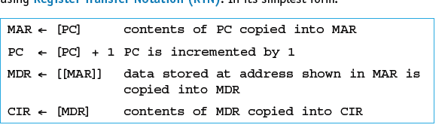
Register Transfer Notation (RTN)
When registers are involved, it is possible to describe what is happening by using Register Transfer Notation (RTN).
In its simplest form:
Double brackets are used in the third line because it is not MAR contents being copied into MDR but it is the data stored at the address shown in MAR that is being copied to MDR.

